Slide 1

SRM INSTITUTE OF SCIENCE AND TECHNOLOGY Ramapuram Campus , Chennai – 600 089 DEPARTMENT OF COMPUTER SCIENCE AND ENGINEERING
18CSP107L-MINOR PROJECT
HirePulse Job Portal
BATCH NUMBER : 21
Team Members | Supervisor
Surya Siddharth G-RA2111003020492 | NAME: Dr. R Subashini

Slide 2
Agenda
Abstract
Scope and Motivation
Introduction
Literature Survey
Objective
Problem Statement
Architecture Diagram
Novel Idea
Software and Hardware Requirements
Implementation
Results
References
Outome

Slide 3
Abstract
HirePulse is an innovative job portal designed to transform the employment landscape through the use of advanced algorithms and user centric features. The platform caters to both job seekers and employers, providing a seamless and efficient job experience.
For job seekers, HirePulse offers a comprehensive suite of tools, including personalized job recommendations, Resume-building assistance, and real-time application tracking. Leveraging artificial intelligence, the portal analyzes user profiles, skills, and preferences to match candidates with the most suitable job opportunities, significantly reducing the time and effort involved in the job search process.
Employers benefit from a robust set of features designed to streamline the hiring process. Advanced filtering options, candidate matching algorithms, and automated scheduling tools enable employers to quickly identify and connect with top talent. HirePulse also incorporates feedback mechanism, allowing for continuous improvement of the job matching process based on user interactions and outcomes.

Slide 4
Scope and Motivation
Scopes:
AI-Driven Job Matching: Provide accurate job matches and personalized recommendations using advanced AI algorithms.
Employer Tools: Streamline hiring with advanced filtering, candidate matching, and automated scheduling features.
User-Centric Features: Offer resume builders, career advice, and real-time application tracking for job seekers.
Data Privacy: Ensure robust data protection and compliance with privacy regulations.
Market Expansion: Extend reach across industries and regions, including remote and freelance opportunities.
Continuous Innovation: Integrate latest AI advancements and regularly update the platform based on user feedback.

Slide 5
Scope and Motivation
Motivation:
Address Employment Gaps: Connect job seekers with relevant opportunities to reduce unemployment.
Enhance User Experience: Simplify job search and hiring processes with an intuitive, user-friendly platform.
Empower Job Seekers: Provide tools and resources to improve employability and career prospects.
Streamline Hiring: Save employers time and resources, reducing time-to-hire and improving hire quality.
Foster Dynamic Job Market: Create an interconnected market for efficient talent discovery and matching.
Build Trust: Ensure transparency, security, and reliability to establish long-term user relationships.

Slide 6
Literature Survey
S.No | Title Of the Project | Year | Journal/Conference Name | Inferences
1. | A survey on skill identification from online job ads. | 2021 | IEEE | This inference refers that it takes survey on skill identification.
2. | Feature extraction based online job portal. | 2022 | IEEE | This inference refers that it can benefits the features for Job seekers as well as the employers.

Slide 7
Literature Survey
S.No | Title Of the Project | Year | Journal/Conference Name | Inferences
3. | Exploration and Integration of Job Portals in Vietnam. | 2020 | IEEE | This inference refers that instead of referring the Job advertisements in Newspaper, We can Explore the selected jobs in job portal.
4. | Integrated Web Application for Skill Development and Job Application. | 2021 | IEEE | This inference refers that it integrate both skill development as well as Job Application.

Slide 8
Literature Survey
S.No | Title Of the Project | Year | Journal/Conference Name | Inferences
5. | Agile and UX Application in Design and Development of Job Portal Web Application. | 2023 | UTHM | In this inference refers that this job portal developed by using agile form.
6. | Job Management Portal Software Review. | 2023 | Portland State University | The journal provides a comprehensive review of job management portal software, evaluating its features, performance, and usability.

Slide 9
Objectives
Optimize Job Matching:
Develop and refine AI algorithms to ensure highly accurate and relevant job matches for users.
Continuously improve the recommendation system based on user feedback and interaction data.
Enhance User Experience:
Create a seamless, intuitive interface for both job seekers and employers.
Offer comprehensive support tools such as resume builders, career advice, and real-time application tracking.
Streamline Hiring Processes:
Provide employers with efficient tools for candidate filtering, matching, and communication.
Reduce the time-to-hire and improve the overall quality of hires through advanced technology.
Ensure Data Security:
Implement robust data protection measures to safeguard user information.
Maintain compliance with industry standards and regulations on data privacy.
Expand Market Reach:
Adapt the platform to cater to a variety of industries and geographic regions.
Include support for remote and freelance job opportunities to meet evolving market demands.
Foster Continuous Improvement:
Regularly update the platform with new features and enhancements based on user feedback.
Integrate the latest advancements in AI and machine learning to stay ahead of industry trends

Slide 10
Objectives
Build a Trusted Brand:
Establish HirePulse as a reliable and trustworthy job portal through consistent delivery of value.
Foster long-term relationships with users by ensuring transparency and reliability in all interactions.
Promote Career Development:
Provide job seekers with resources and tools to enhance their skills and career prospects.
Offer personalized career guidance to help users make informed decisions.
Support Employers:
Assist employers in finding and retaining top talent through effective matching and communication tools.
Offer insights and analytics to help employers optimize their hiring strategies.
Contribute to Economic Growth:
Facilitate the movement of skilled labor across sectors to support economic development.
Reduce unemployment by efficiently connecting job seekers with available opportunities.

Slide 11
Novel Ideas
AI-Enhanced Skill Gap Analysis:
Implement a feature that identifies skill gaps for job seekers and suggests targeted courses or certifications to bridge those gaps.
Partner with educational platforms to offer discounted courses directly through HirePulse.
Gamified Job Search Experience:
Introduce gamification elements like badges, rewards, and progress tracking to make the job search more engaging and motivating.
Offer rewards for completing profile sections, applying for jobs, and participating in skill assessments.
Virtual Reality (VR) Job Previews:
Allow job seekers to experience a virtual day-in-the-life of a potential job using VR technology.
Enable employers to create immersive job previews to attract high-quality candidates.
AI-Driven Career Pathway Planning:
Provide users with AI-driven career pathway recommendations based on their skills, experiences, and career goals.
Suggest potential career transitions and the necessary steps to achieve them, including additional education or certifications.
Blockchain-Based Credential Verification:
Implement blockchain technology for secure and verifiable credentialing, ensuring the authenticity of candidates' qualifications and certifications.
Streamline the verification process for employers, enhancing trust and reducing time-to-hire.

Slide 12
Novel Ideas
Social Media Integration for Personal Branding:
Integrate with social media platforms to allow job seekers to showcase their personal brand, professional networks, and endorsements.
Enable employers to view a comprehensive profile that includes social media activity, professional achievements, and peer recommendations.
AI-Powered Soft Skills Assessment:
Develop AI tools to assess soft skills through interactive simulations and situational judgment tests.
Provide feedback and improvement tips to job seekers, helping them enhance their interpersonal and communication skills.
Dynamic Video Resumes and Interviews:
Allow job seekers to create dynamic video resumes highlighting their skills and experiences.
Facilitate asynchronous video interviews where candidates can respond to pre-recorded questions at their convenience.
AI-Driven Diversity and Inclusion Metrics:
Implement AI tools to help employers measure and improve diversity and inclusion in their hiring processes.
Provide insights and recommendations to ensure a fair and inclusive recruitment strategy.
Mentorship and Networking Platform:
Create a mentorship program connecting job seekers with industry professionals for career guidance and networking opportunities.
Facilitate virtual networking events and webinars to help users expand their professional connections.

Slide 13
Novel Ideas
Job Market Insights and Trends:
Offer real-time job market insights, trends, and salary benchmarks to help users make informed career decisions.
Provide employers with data-driven insights to optimize their hiring strategies and stay competitive in the market.
Personalized Job Search Assistants:
Introduce AI-powered personal job search assistants that help users navigate the platform, find suitable job matches, and provide real-time updates and reminders.
Offer chatbots and voice assistants for a more interactive and personalized user experience.

Slide 14
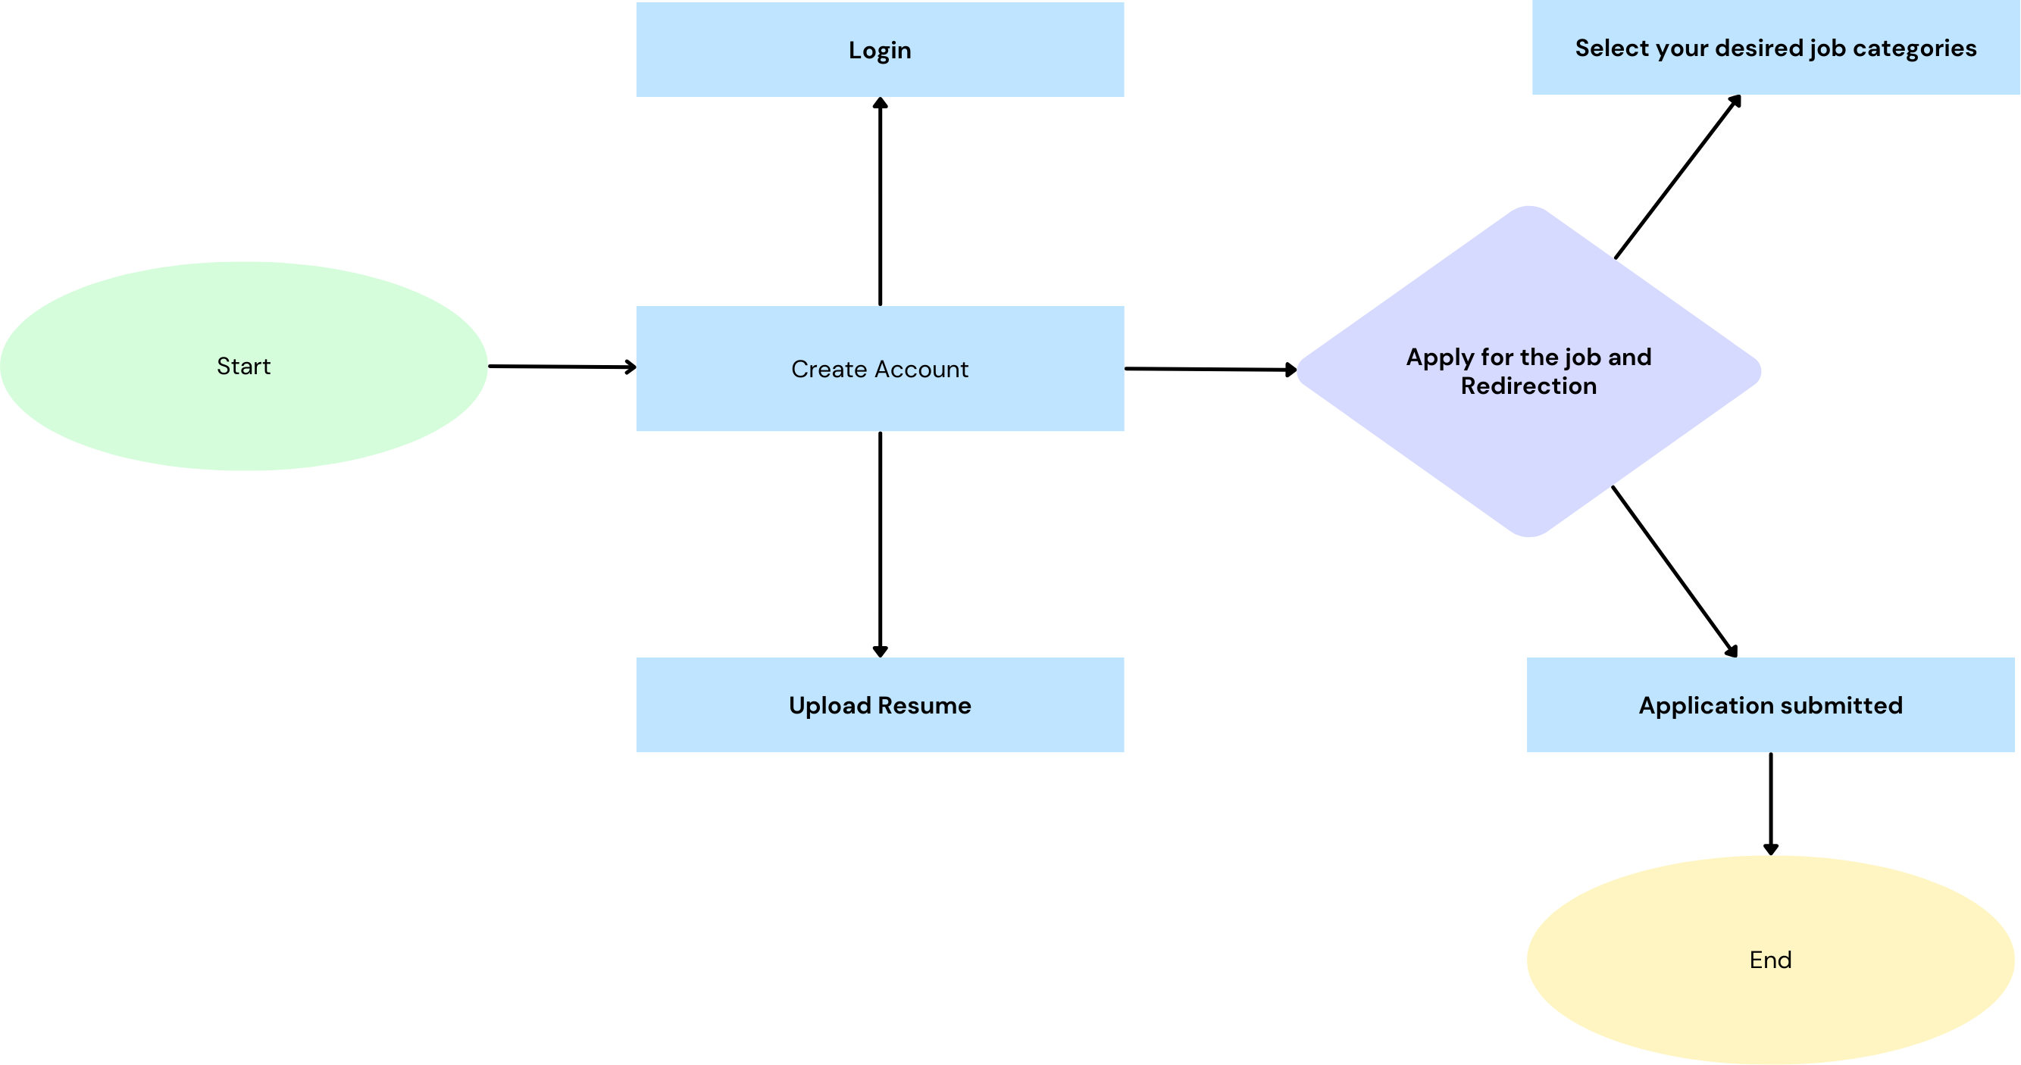
Flowchart Diagram

Slide 15
Problem Statement
The problem statement of the HirePulse Job Portal includes the following key points:
Inefficient Job Matching: Difficulty in accurately matching job seekers with appropriate job opportunities.
User Experience Issues: Challenges in providing a seamless and user-friendly experience for both job seekers and employers.
Data Management Problems: Complications in handling and organizing large volumes of data related to job listings and applicant information.
Scalability Concerns: Struggles in scaling the platform to accommodate growing numbers of users and job listings.
Security Risks: Risks associated with protecting sensitive user data and maintaining privacy standards.
These points highlight the core issues that the HirePulse Job Portal aims to address.

Slide 16
Software & Hardware Requirements
Software:
Web Technologies: HTML, CSS3, and JavaScript.
Frameworks: React.js, Bootstrap
Development Tools: Node.js, Webpack, Babel.
Version Control: Git, GitHub.
APIs: RESTful APIs for backend comunication.
Hardware:
Processor: Intel i3 or equivalent.
RAM: Minimum 4GB.
Storage: At least 256GB.
Display: Full HD (1920x1980)
Internet Connection: Stable broadband connection for development and testing.

Slide 17
References
[1] Marjan Mansourvar and Norizan Binti Mohd Yasin, “Development of a job web portal to improve education quality,” International Journal of Computer Theory and Engineering, Vol. 6, No. 1, February 2014.
[2] Vivek Kumar Sehgal Akshay Jagtiani, Meha Shah, Anupriya Sharma, Arpit Jaiswal and Dhananjay Mehta, “Job Portal – A web application for geographically distributed multiple clients,” 2013 First International Conference on Artificial Intelligence, Modelling & Simulation.
[3] Pooja T. Killewale and Prof. A.R. Mune, “Job Portal – A web application for distributed clients,” International Journal of Advanced Research in Computer and Communication Engineering, Vol. 6, Issue 5, May 2017.
[4] Malgorzata Mochol, Holger Wache and Lyndon Nixon, “Improving the accuracy of job search with semantic techniques,” Conference Paper, April 2007.
[5] Abubucker Samsudeen Shaffi and Mohaned Al-Obaidy, “Analysis and comparative study of traditional and web information systems development methodology (WISDM) towards web development applications,” International Journal of Emerging Technology and Advanced Engineering, Volume 3, Issue 11, November 2013.

Slide 18
Implementations

Slide 19
Intermediate Results

Slide 20
Outcome
The outcomes of the HirePulse Job Portal include:
Enhanced Job Matching: Improved accuracy in matching job seekers with relevant job opportunities.
Improved User Experience: A more user-friendly interface for both job seekers and employers, leading to higher satisfaction.
Efficient Data Management: Better organization and handling of job listings and applicant information.
Scalability: The ability to accommodate a growing number of users and job listings without compromising performance.
Increased Security: Enhanced measures to protect user data and maintain privacy standards.
These outcomes highlight the key benefits and improvements achieved through the HirePulse Job Portal

